Slide 1
Database Connections From Java
Install JDBC driver for your version of Java.
Add JDBC driver as external jar file to Java project.
  May need to add authorization dll as run-time argument.
In your Java code:
  Make connection.
  Create Statement object (or Prepared Statement object, if the SQL query has variables).
  Create SQL query as string with ? for variables.
  Bind any variables.
  Execute query.
    Exact syntax depends on what type of query.
  Examine results.
  Use meta-data to get information about table.
  Don't forget to close statement and connection.

Slide 2
JDBC
Java Database Connectivity (JDBC) is a set of programs that allows for Java programs to connect to and interact with database systems.
It provides a middleware layer between the application and the database system.
  The application programmer needs to know how to use the JDBC API.
  Each vendor provides drivers so JDBC can access their database.
  JDBC’s driver manager is in charge of managing all database connections and converts the queries into the appropriate format for the specific database system.
JDBC was developed by Sun, now owned by Oracle. It can make use of ODBC, through a JDBC-ODBC “bridge”, which converts JDBC statements into the corresponding ODBC statements.

Slide 3
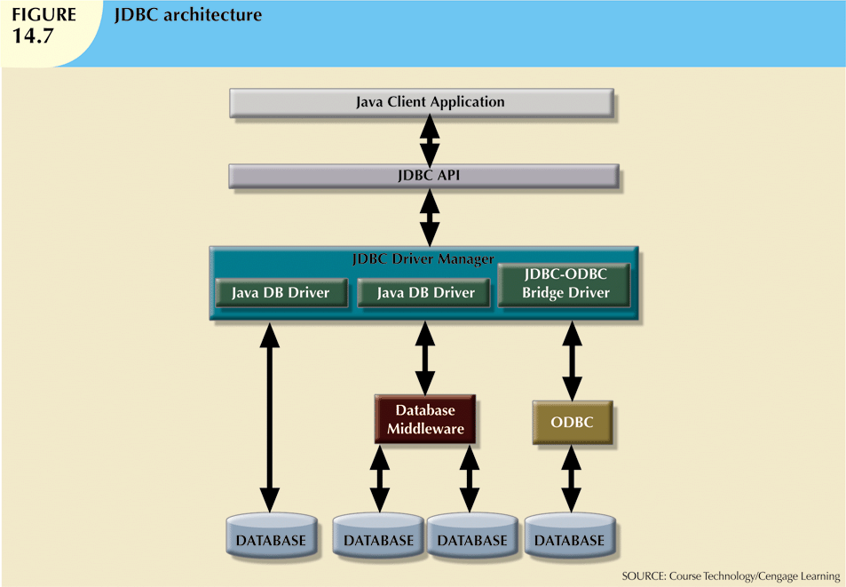
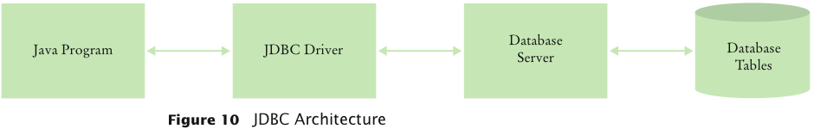
Database Systems, 10th Edition
"Big Java", by C. Horstmann

Slide 4
JavaDB (Derby)
Java includes a light-weight, open-source relational database system called Apache Derby, or JavaDB.
JavaDB uses the version of SQL that goes with IBM DB2.
Many Java textbooks illustrate how to use JavaDB from a Java program.
We will NOT do that here. We will illustrate how to connect to SQL Server from a Java program.

Slide 5
Download JDBC Driver
Get the appropriate JDBC driver for the DBMS.
E.g. for SQL Server, go to http://msdn.microsoft.com/en-us/sqlserver/aa937724.aspx and click Download JDBC Driver, then Download.
We want enu\sqljdbc_6.0.7728.100_enu.exe (the 2nd from the top).
After downloading, double-click to extract it. Make sure you know where everything is extracted to.
Go into the enu sub-folder of the extracted folder; you will see some jar files.
  A jar file is a compressed collection of Java classes. (jar stands for “Java Archive”).
We need to add sqljdbc42.jar to our Java code.

Slide 6
Include JDBC Driver in Java Project
Add sqljdbc42.jar to your Java code so that all the classes will be added to the program when it is compiled.
In Eclipse:
  Right-click on the project.
  Select Properties->Java Build Path
  Choose Libraries tab
  Add External Jars
  Browse to directory and select the JDBC driver file; e.g. sqljdbc42.jar .
  Click OK.

Slide 7
Add Folder for Authorization DLL
If you are connecting to SQL Server using Windows Authentication, need to add the folder containing the appropriate authorization dll file as a run-time argument.
NOTE: A dll (dynamic-linked library) is a piece of binary code that is added to the program when the program runs.
There are 2 subdirectories of JDBCDriver/enu/auth ,
  One for 32-bit machines, one for 64-bit.
Pick the appropriate folder and add it as a run-time argument to your project.

Slide 8
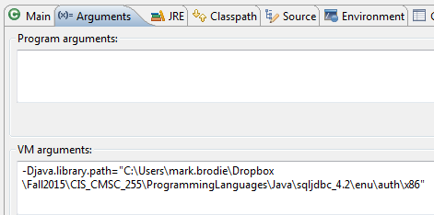
Add Authorization DLL in Eclipse
Adding authorization dll in Eclipse:
  Right-click on Java class you want to run. Select Run As -> Run Configurations.
  Add the following to Arguments -> VM Arguments.
  -Djava.library.path=<<specify folder here as string>>
  NOTE: No spaces around the equal sign! (see pic below)
  Click Apply and then Run.

Slide 9
Create Database Connection
First, import the appropriate package.
import java.sql.*;
Two ways to make a connection:
Connect without specifying database; then include database name in all queries.
  String url = "jdbc:sqlserver://localhost:1433; integratedSecurity = true";
  Localhost can be replaced by actual server name.
(2) Connect to a specific database; then don’t need database name in queries.
  String url = "jdbc:sqlserver://localhost:1433; database = TSQL2012; integratedSecurity = true";
NOTE: 1433 is SQL Server’s default port number.
Setting integratedSecurity to true means use Windows Authentication.

Slide 10
Create Database Connection (ctd)
Then do the following:
Connection connection = DriverManager.getConnection(url);
Need to either throw SQLException or surround with try/catch.
If no error occurs, the connection is established. ☺
Now can issue queries.
Don’t forget to close connection when done!
  connection.close();
NOTE: It is also possible to call DriverManager.getConnection(url, userName, password)
(if not using Windows Authentication).

Slide 11

Possible Errors
Exception in thread "main" java.sql.SQLException: No suitable driver found for jdbc:sqlserver://localhost:1433; database = TSQL2012; integratedSecurity = true
  Need to include JDBC driver in project.
The TCP/IP connection to the host localhost, port 1433 has failed.
  Need to make sure that SQL Server is listening for connections on port 1433.
    Go to Microsoft SQL Server 2014 -> Configuration Tools -> Configuration Manager -> Network Configuration -> Protocols .
    Right-click TCP/IP and select Enable.
    Also double-click TCP/IP and make sure the TCP Port value for IPAll in the IP Addresses tab is set to 1433.
    Go to SQL Server Services; Stop and then restart the server.

Slide 12
Possible Errors (ctd)
WARNING: Failed to load the sqljdbc_auth.dll cause : no sqljdbc_auth in java.library.path
  Need to add authorization dll.
No response – program hangs. Eventually an error occurs.
  (1) Check spelling of server name.
  (2) Check that server is running. Use SQL Server Configuration Manager to restart the server.
  (3) Check valid login and password.
Exception in thread "main" com.microsoft.sqlserver.jdbc.SQLServerException: Cannot open database "T SQL2012" requested by the login. The login failed.
  Check spelling of database name. Make sure database exists.

Slide 13
Statement Objects
Once there is a connection, create a Statement or PreparedStatement object.
  PreparedStatements are for statements with variable parts – see later.
Statement statement = connection.createStatement();
A statement object can issue queries, created as strings.
A few statement methods:
  ResultSet executeQuery(String query)
    Use for SELECT statements.
    Returns a ResultSet object.
  boolean execute(String query)
    Use for CREATE, INSERT, DELETE statements, which either succeed or fail.

Slide 14
Analyzing Query Results
When a ResultSet object is returned from an executeQuery, no row data are immediately available.
Use the next method to move to the first row of the query results.
Use the next method to iterate through the results one row at a time.
The next method returns a boolean value indicating whether more rows of data are available:
while (result.next())
{
Inspect data from the current row
}

Slide 15
Get Column Values From a Row
There are two get methods for each type of data (string, integer, double ...) that can be used to get attribute values from a row.
(1) Use an integer parameter that indicates the column position, starting at 1.
  String productCode = result.getString(1);
(2) Use a string parameter for the column name:
  String productCode = result.getString("Product_Code");
Use getInt to fetch an integer column value:
  int quantity = result.getInt("Quantity");
Use getDouble to fetch an double column value:
  double unitPrice = result.getDouble("Price");

Slide 16
Some SQL Types and Their Corresponding Java Types
SQL Data Type | Java Data Type
INTEGER or INT | int
REAL | float
DOUBLE | double
DECIMAL(m, n) | Fixed-point decimal numbers with m total digits and n digits after the decimal point; similar to BigDecimal.
BOOLEAN | Boolean
VARCHAR(n) | Variable-length String of length up to n
CHARACTER(n) or CHAR(n) | Fixed-length String of length n
From Big Java C. Horstmann

Slide 17
Example
String url = "jdbc:sqlserver://localhost:1433; database=TSQL2012; integratedSecurity=true";
Connection connection = DriverManager.getConnection(url);
Statement statement = connection.createStatement();
String custQuery = "Select custid, companyname from Sales.Customers;";
ResultSet result = statement.executeQuery(custQuery);
while (result.next())
{
int id = result.getInt("custid");
System.out.print(id + " ");
String companyName = result.getString("companyname");
System.out.println(companyName);
}
statement.close();
connection.close();

Slide 18
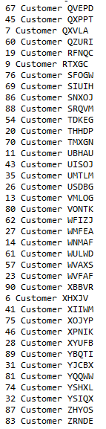
Result

Slide 19
Queries with Variables
Many database queries need variables.
E.g. Suppose we want the orders for a particular customer, but it could be any customer.
A bad solution is to store the customer-id in a variable and concatenate the variable into the query-string.
int userCustomerID = // get customer-id from user.
String query = "Select orderid, orderdate from Sales.Orders WHERE custid = " + userCustomerID + ";";
This approach makes the database vulnerable to SQL injection attacks.

Slide 20
Prepared Statements & Bind Variables
If a statement has variable parts, use a PreparedStatement object.
  String query = "Select orderid, orderdate from Sales.Orders Where custid = ?;";
  PreparedStatement statement = conn.prepareStatement(query);
The question-mark denotes a bind variable that the DBMS fills in when it executes the actual query.
  This is more efficient, and avoids SQL injection attacks!

Slide 21
Prepared Statements - set
Call the set method to fill in any variables in a prepared statement object.
For example, for string variables:
  statement.setString(1, accountNumber);
  The first parameter in the set methods denotes the variable position
  1 is the 1st question-mark, 2 the 2nd question-mark, etc.
There are also methods setInt, setDouble, etc, to set other types of variables.
Set all variables, then call executeQuery or execute.

Slide 22
Result Set Meta Data
Result set meta-data describes the properties of the result set.
Get the meta-data object from the result set:
  ResultSetMetaData metaData = result.getMetaData();
Use the ResultSetMetaData class to find out the column names in an unknown table.
  Use getColumnCount method to get the number of columns.
  Use getColumnLabel method to get the name of each column.
  Use getColumnDisplaySize method to get the column width.
  for (int i = 1; i <= metaData.getColumnCount(); i++)
  {
  String columnName = metaData.getColumnLabel(i);
  int columnSize = metaData.getColumnDisplaySize(i);
  ...
  }

Slide 23
Multiple Result Sets
The same Statement object can issue multiple queries, but only one ResultSet object is active for each Statement object at one time.
If you need to look at multiple result sets at the same time, create multiple Statement objects.
Close the current ResultSet before issuing a new query on the same statement:
  result.close();
When you are done with a Statement object, close it:
  statement.close();
  That will also close the ResultSet.

Slide 24
Very Important!!!
Don’t use your programming language to do things that the database can do for you!
  The database will always be faster.
E.g. Suppose you want to know how many customers are in Hawaii.
Do this (have the database do the count)
ResultSet result = stat.executeQuery(
"SELECT COUNT(*) FROM Customer WHERE State ='HI'");
result.next();
int count = result.getInt(1);
DON’T do this (retrieve that part of the table and count the rows)
int count = 0;
ResultSet result = stat.executeQuery(
"SELECT State FROM Customer WHERE State = 'HI'");
while (result.next()) count++;

